Slide 1
Announcements

Slide 2
From last time
You want to model time from order to package delivery as a function of the weight of the ordered items. Is this classification, regression, or clustering?
You are training a model to group together points with similar feature values. Are you using supervised or unsupervised learning?
Your model has 6,000 parameters, and you’re using 3 feature functions for input. Are you likely to overfit? Yes or No.
What is your current biggest question about machine learning (or significance testing)?

Slide 3
What is overfitting?
Overfitting is when a model learns to do really well on the training data, but generalizes badly to test data
Visualize with a learning curve
Graphs error on train/test set over learning iterations
Overfitting
Error
Test set error
Basically, the model memorizes the training set, instead of learning its distribution
Training set error
Learning iterations

Slide 4
Today’s learning goals
At the end of today, you should be able to
Explain considerations in choosing feature functions
Describe and implement k-Nearest Neighbors classification
Describe and implement k-Means clustering
Describe gradient descent for learning model parameters

Slide 5
How do we actually learn these things?
In general, follow a Bayesian style of learning:
Start with an initial model (the prior)
Sample data and get feedback on how well our model describes the samples
Use the feedback to adjust the model (get a posterior)
Questions we’ll talk about for the rest of today:
What kind of feedback do we use?
What can/should the model look like?
How do we represent the data?

Slide 6
Representing data
Data comes in many forms:
Images
Text
Audio
Communication metadata
Network packets
Etc.
To use mathematical functions, we need to turn these into vectors of numbers!

Slide 7
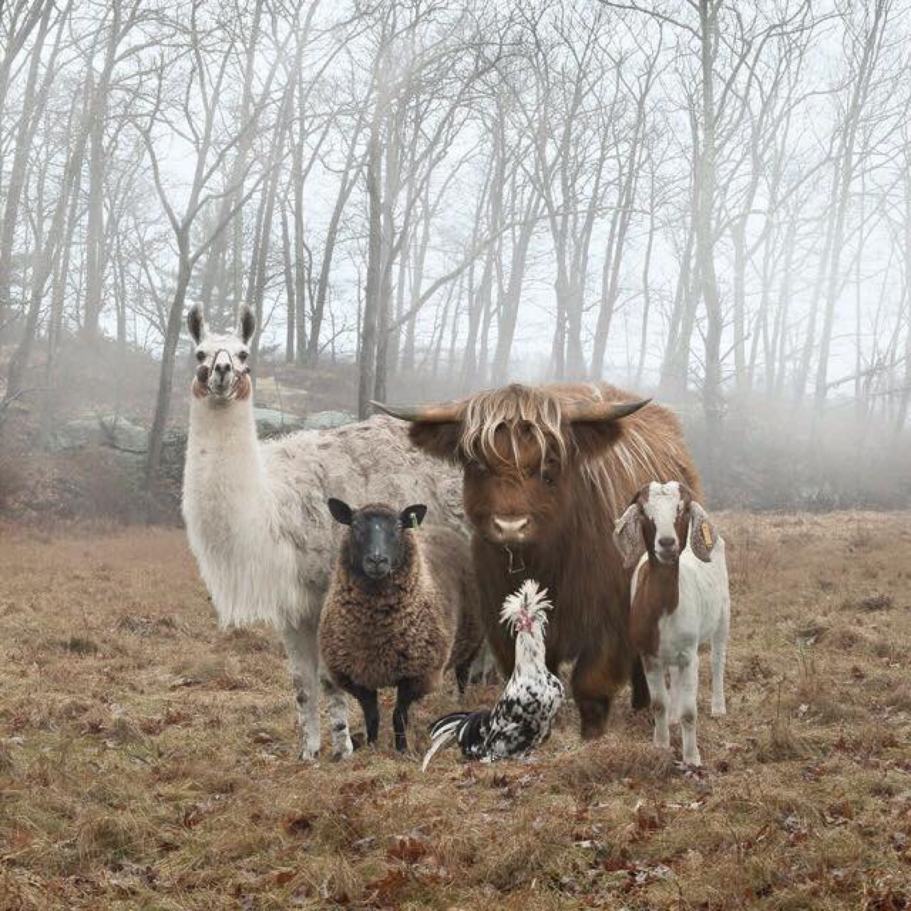
Representing data
For machine learning, we need feature functions to describe aspects of data.
Low-level features
Proportion of bright green = 0
Pixel size = 1280x1280
Mean intensity = 0.6
Std dev intensity = 0.2
High-level features
Number of animals = 5
HasForestBackground = 1
Image examples

Slide 8
Representing data
For machine learning, we need feature functions to describe aspects of data.
Low-level features
Freq(the) = 3
# distinct chars = 39
% numbers = 20%
High-level features
# of verbs = 3
RegardsLlamas = 1
Text examples
The height of a full-grown, full-size llama is 1.7 to 1.8 m (5.6 to 5.9 ft) tall at the top of the head, and can weigh between 130 and 200 kg (290 and 440 lb). At birth, a baby llama (called a cria) can weigh between 9 and 14 kg…

Slide 9
How to choose feature functions?
Tradeoff 1
The more features you use, the better a picture of your data you can paint.
But also the more model parameters you need!
Tradeoff 2
Lower-level features are (usually) easier/faster to compute
But they may be less informative

Slide 10
How to choose feature functions?
In general, we want to choose feature functions that seem:
Informative to the task at hand
Easy to compute
Not redundant to other features
The process of deciding which features to use is often empirical
i.e., try it, see how it works, and adjust
Crafting a set of good features is called feature engineering.

Slide 11

Example: choosing feature functions
Task setting: email classifier
Inputs:
Body text
Subject text
Sender
Attachment name
Output:
Is this email (a) Spam, (b) Important, or (c) Other?

Slide 12
Example: choosing feature functions
Potential feature functions:
Frequency of “the” (int)
Frequency of “dollars” (int)
Number of mis-spelled words (int)
All caps in subject (bool)
Number of verbs (int)
Number of grammatically correct sentences (int)
Is “pills” present? (bool)
Frequency of “money” (int)

Slide 13
Example: choosing feature functions
Potential feature functions:
Frequency of “the” (int)
Frequency of “dollars” (int)
Number of mis-spelled words (int)
All caps in subject (bool)
Number of verbs (int)
Number of grammatically correct sentences (int)
Is “pills” present? (bool)
Frequency of “money” (int)
Not informative
Too hard
Probably redundant

Slide 14
k Nearest Neighbors classification
Nonparametric method
i.e., we choose a model structure, but no explicit parameters to learn
Algorithm
Given an input test point P, find the k points in the training set with smallest distance to P
Count up their labels as “votes”
Label P as the class with the highest vote count
k is a hyperparameter – a part of the model structure that we have to choose

Slide 15
k-NN classification
Given
Labeled data
Test point P ( )
Euclidean distance
Algorithm
Find the k labeled points with smallest distance to P
Count up their labels as “votes”
Label P as the class with the highest vote count
1
Votes
2

Slide 16
k-NN classification
Given
Labeled data
Test point P ( )
Euclidean distance
Algorithm
Find the k labeled points with smallest distance to P
Count up their labels as “votes”
Label P as the class with the highest vote count
1
Votes
2

Slide 17
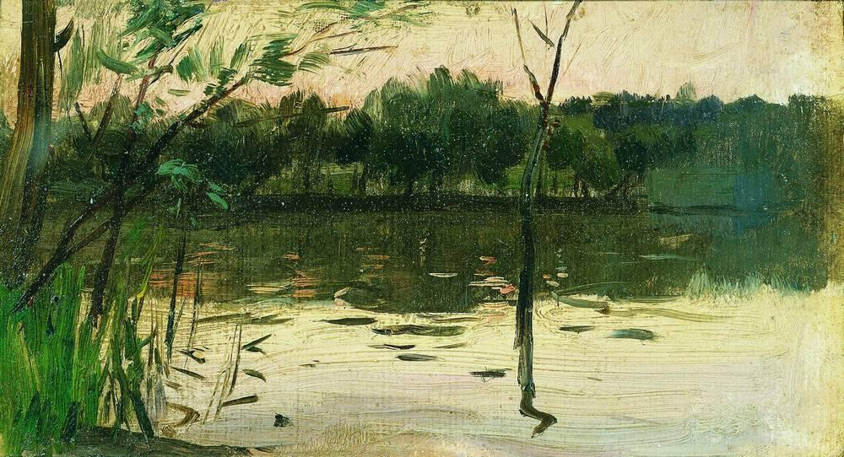
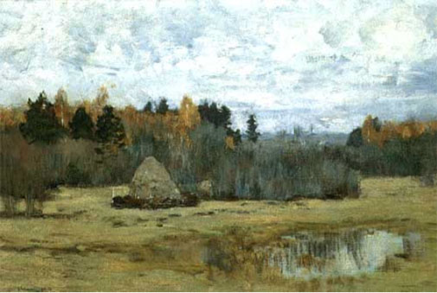
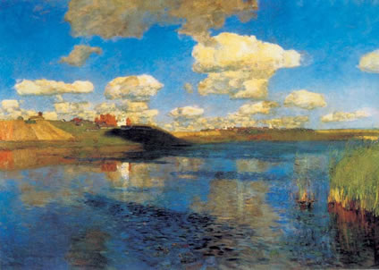
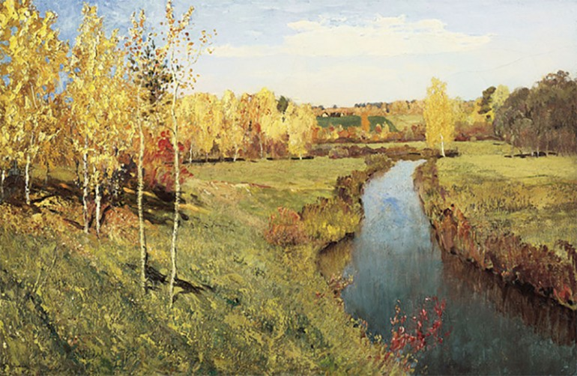
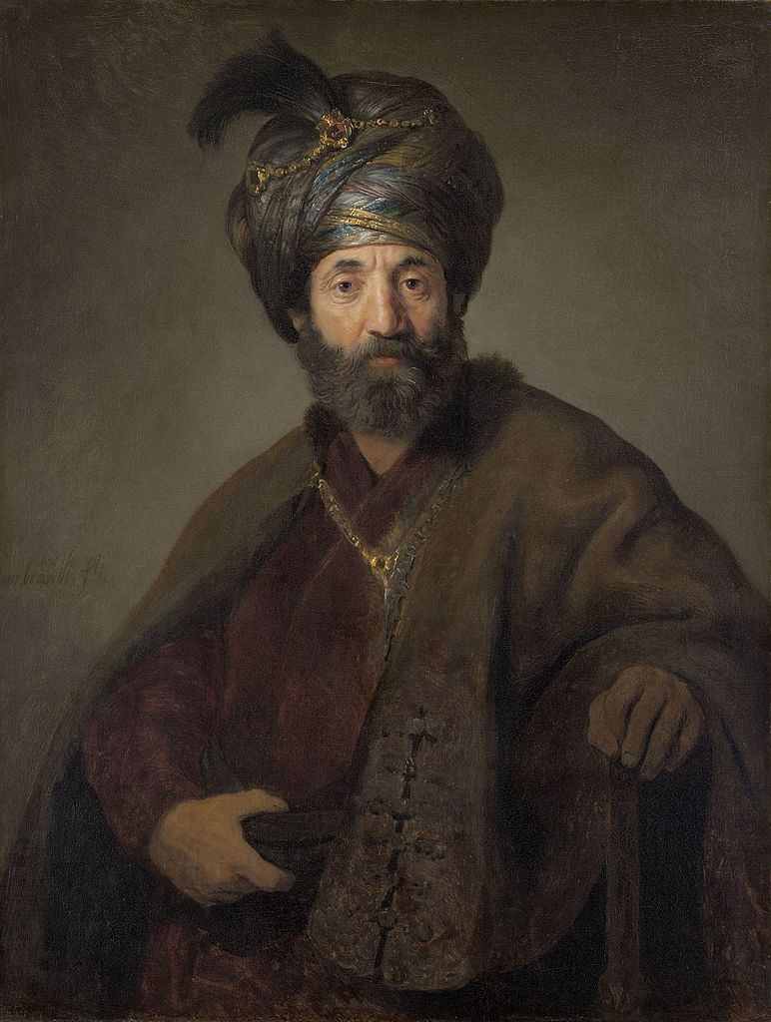
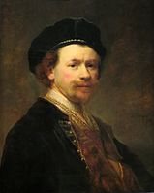
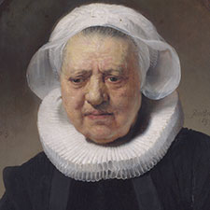
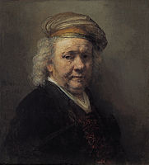
Example: feature representations for k-NN
Landscapes
Portraits

Slide 18
One feature - Height:Width ratio
0.652
1.33
1.10
0.671
0.542
1.0
1.25
0.712
0.5
0.75
1.0
1.25
1.5
Height:Width ratio

Slide 19
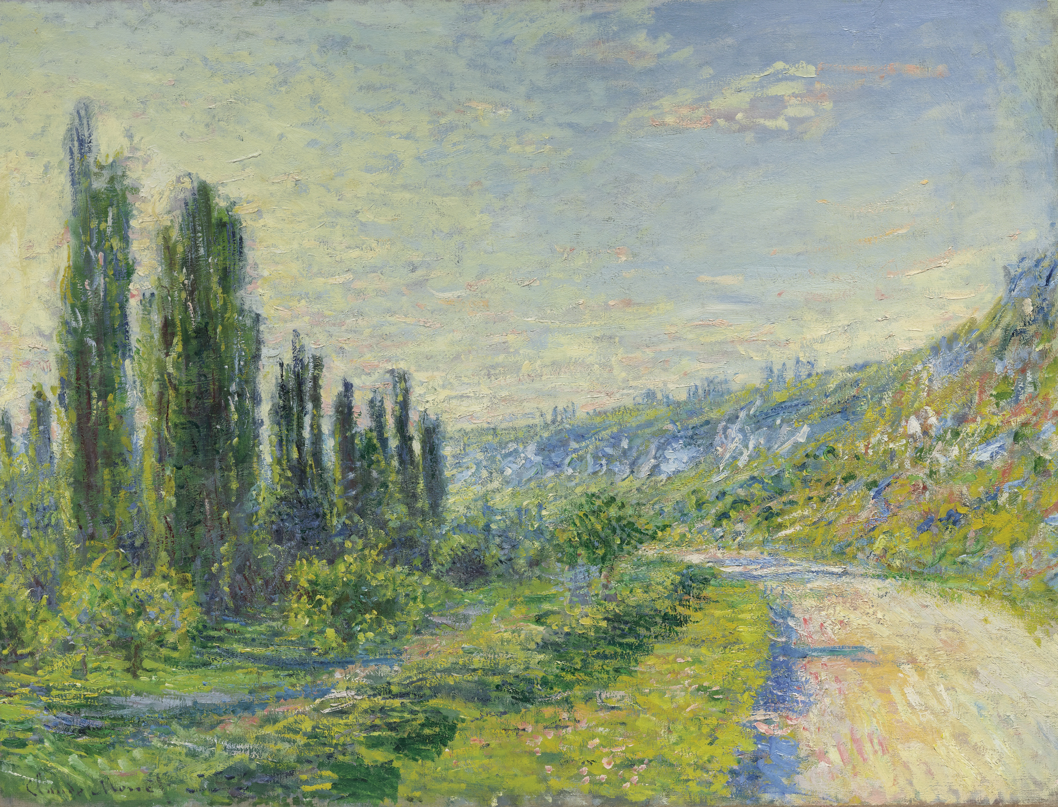
One feature - Height:Width ratio
0.763
0.652
1.33
1.10
0.671
0.542
1.0
1.25
0.712
0.5
0.75
1.0
1.25
1.5
Height:Width ratio

Slide 20

One feature - Height:Width ratio
0.763
0.652
1.33
1.10
0.671
0.542
1.0
1.25
0.712
0.5
0.75
1.0
1.25
1.5
Height:Width ratio

Slide 21
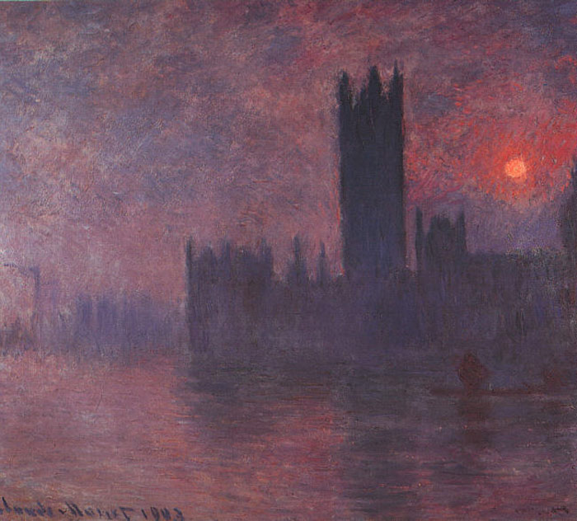
One feature - Height:Width ratio
0.903
0.652
1.33
1.10
0.671
0.542
1.0
1.25
0.712
0.5
0.75
1.0
1.25
1.5
Height:Width ratio

Slide 22

One feature - Height:Width ratio
0.903
0.652
1.33
1.10
0.671
0.542
1.0
1.25
0.712
0.5
0.75
1.0
1.25
1.5
Height:Width ratio

Slide 23
What are other feature representations for these data?
Landscapes
(L3)
(L4)
(L1)
(L2)
Portraits
(P1)
(P2)
(P4)
(P3)
Notes:
Try to think of at least 2, and we’ll do them on the board

Slide 24
What do we need to think about with k-NN?
Choice of k
Lower values means more sensitivity to outliers
Higher values means fuzzier border between classes

Slide 25
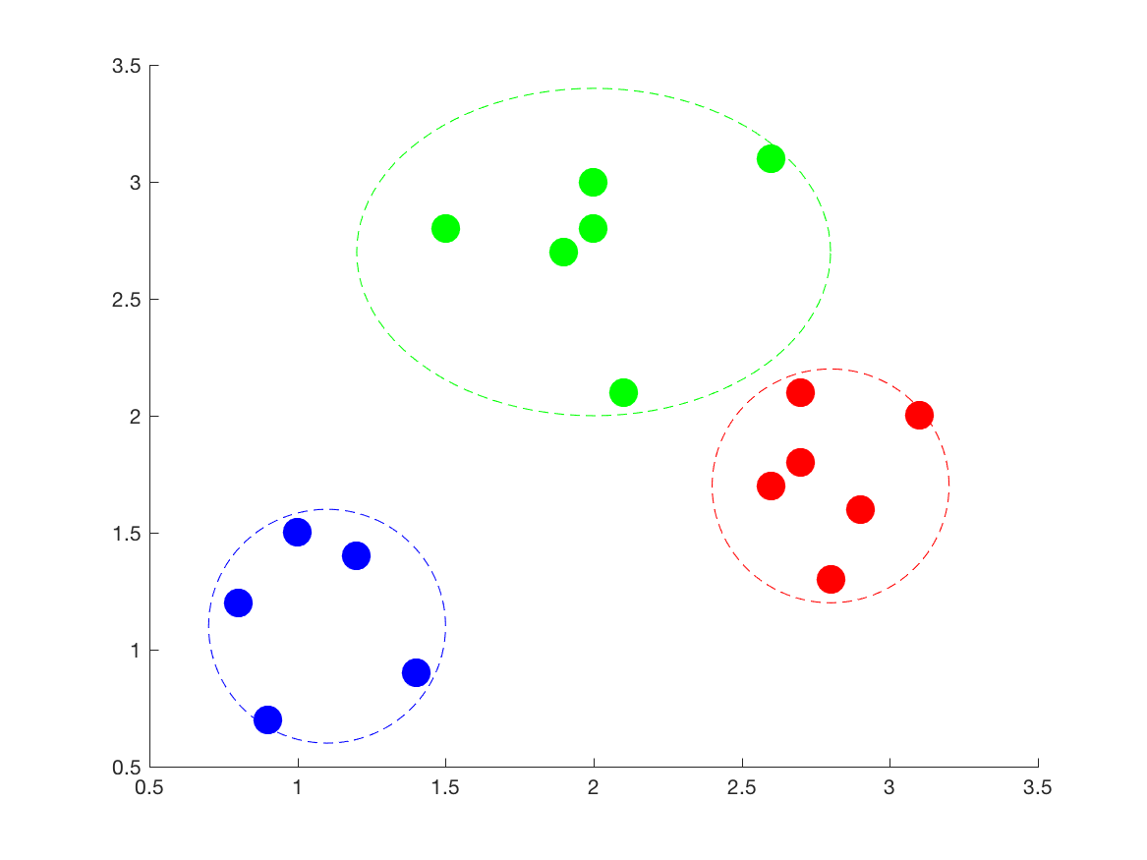
k-Means clustering
Unsupervised learning, so we’re looking for descriptive structure in the data.
Goals:
Describe the data with k clusters
Each point belongs to the center whose centroid it’s most similar to
A cluster’s centroid is the average of its points

Slide 26
k-Means algorithm
Four steps:
Initialize k cluster centroids
Usually uniform random or choose random points in dataset
Assign all points to the cluster with the nearest centroid
Update centroids to the mean of the points in the cluster
If any cluster assignments changed, GOTO (2); otherwise, stop.

Slide 27
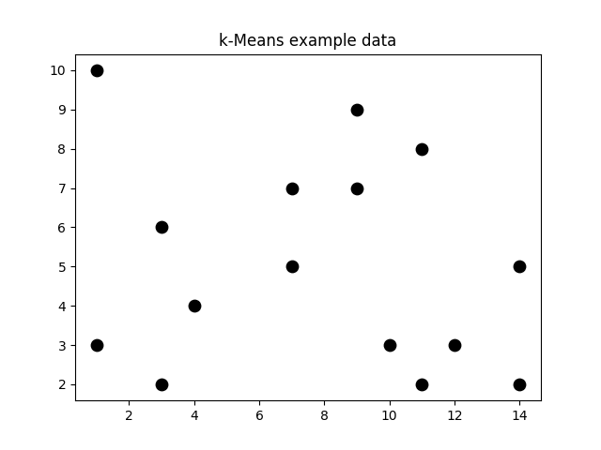
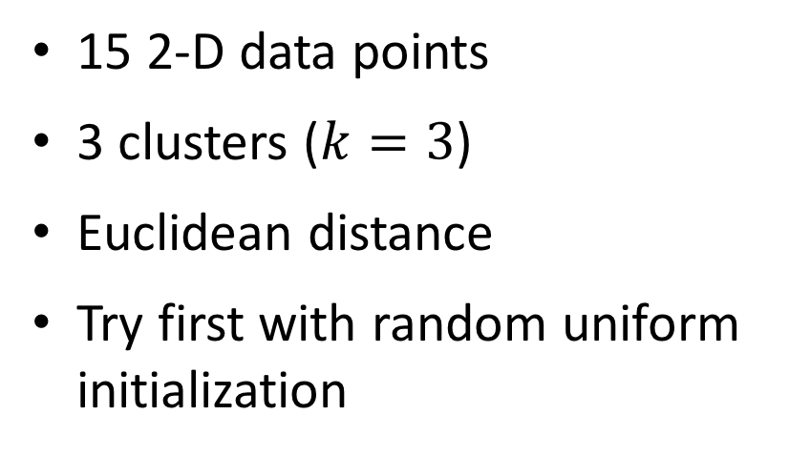
k-Means example
15 2-D data points
3 clusters ($k=3$)
Euclidean distance
Try first with random uniform initialization

Slide 28
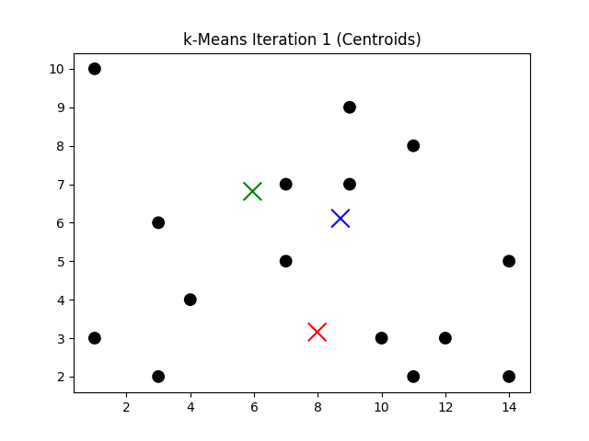
k-Means with random uniform init – Round 1

Slide 29
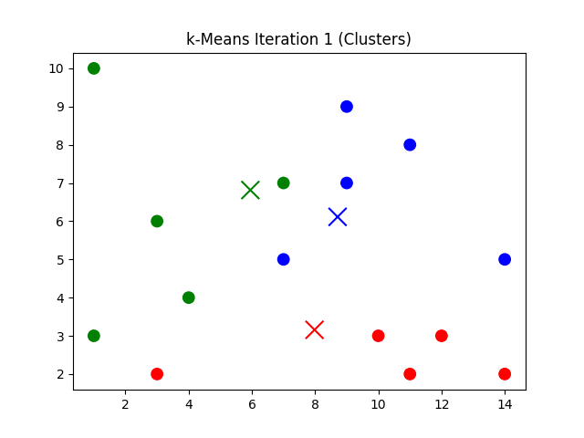
k-Means with random uniform init – Round 1

Slide 30
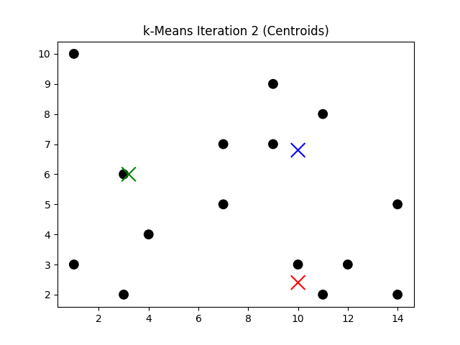
k-Means with random uniform init – Round 1

Slide 31
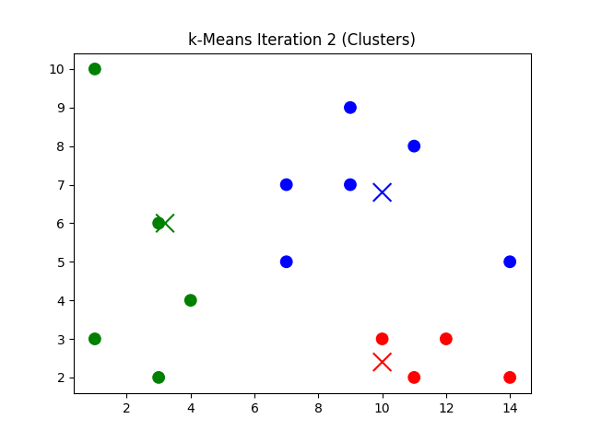
k-Means with random uniform init – Round 1

Slide 32
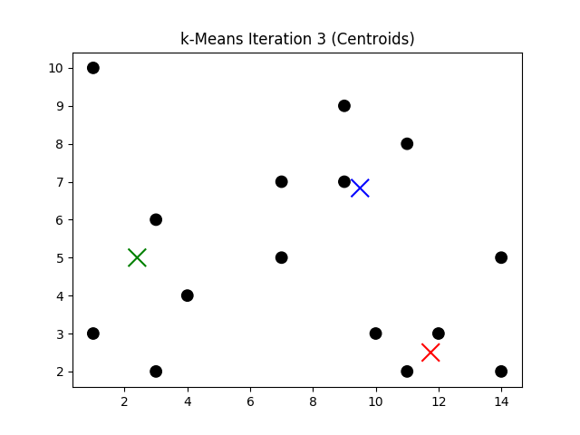
k-Means with random uniform init – Round 1

Slide 33
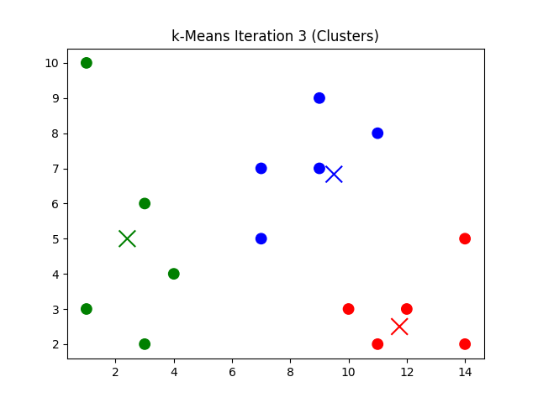
k-Means with random uniform init – Round 1

Slide 34
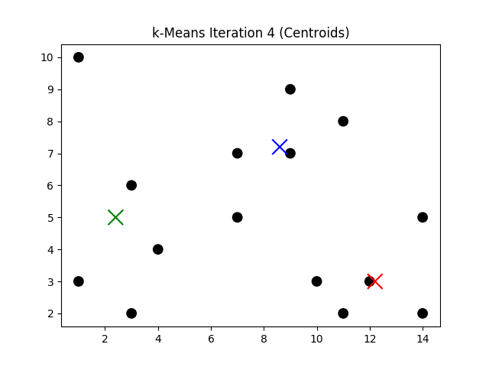
k-Means with random uniform init – Round 1

Slide 35
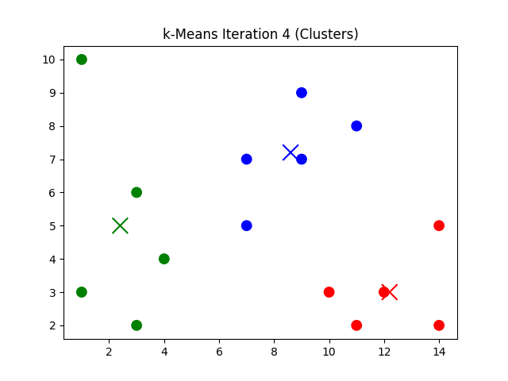
k-Means with random uniform init – Round 1

Slide 36
k-Means with random uniform init – Round 1
All clusterings are the same – we’ve converged!

Slide 37
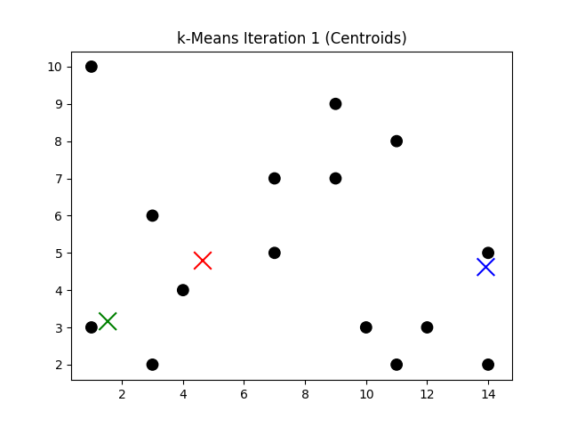
k-Means with random uniform init – Round 2

Slide 38
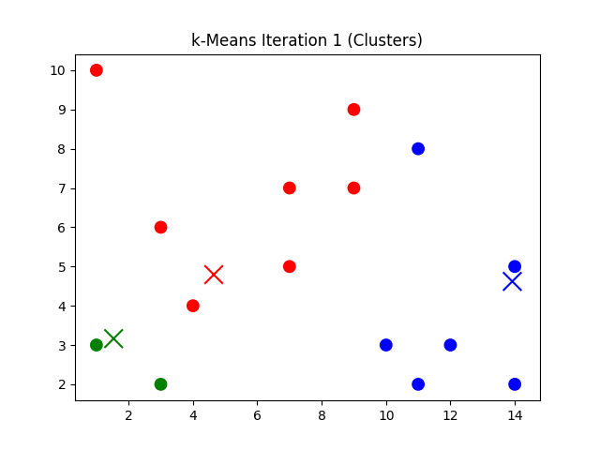
k-Means with random uniform init – Round 2

Slide 39
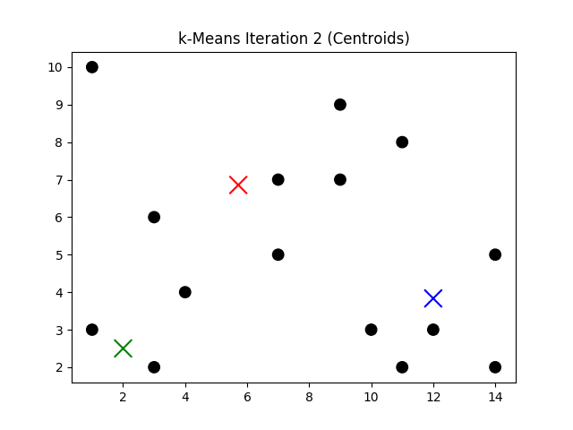
k-Means with random uniform init – Round 2

Slide 40
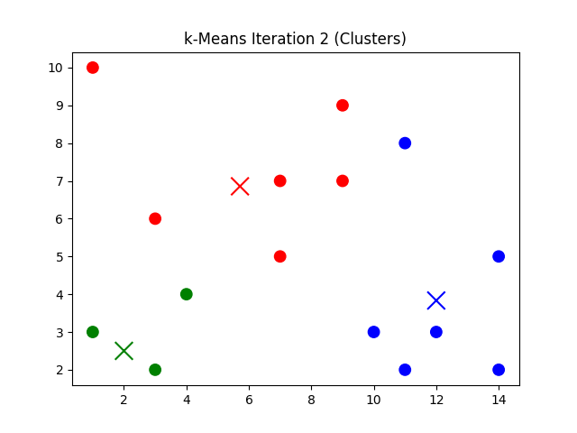
k-Means with random uniform init – Round 2

Slide 41
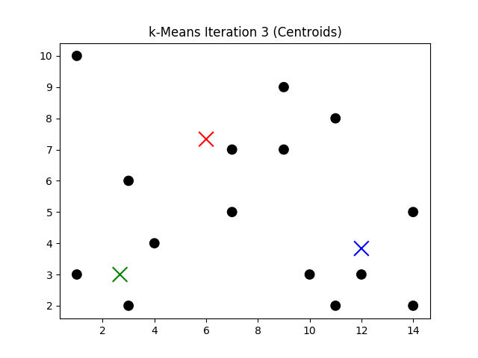
k-Means with random uniform init – Round 2

Slide 42
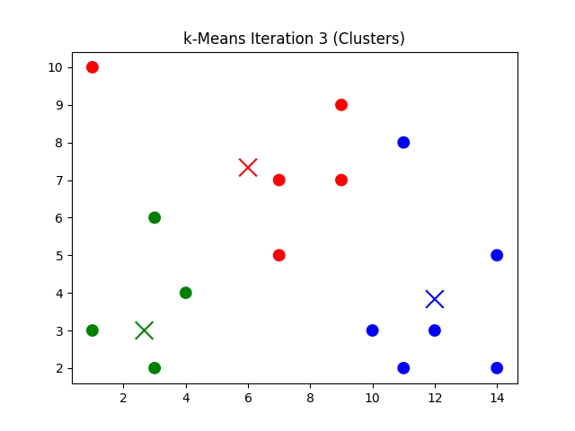
k-Means with random uniform init – Round 2

Slide 43
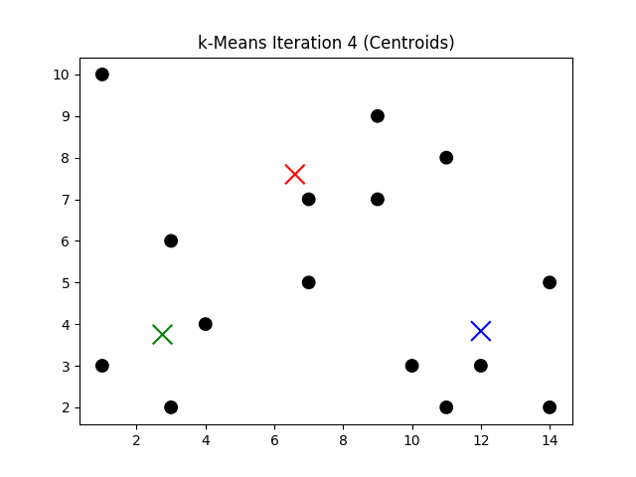
k-Means with random uniform init – Round 2

Slide 44
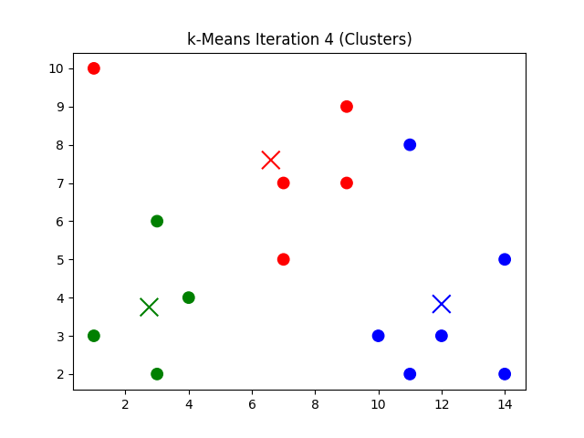
k-Means with random uniform init – Round 2

Slide 45
k-Means with random uniform init – Round 2
All clusterings are the same – we’ve converged!

Slide 46
Round 1 vs Round 2
Round 1
Round 2
Note we didn’t get the same clustering!

Slide 47
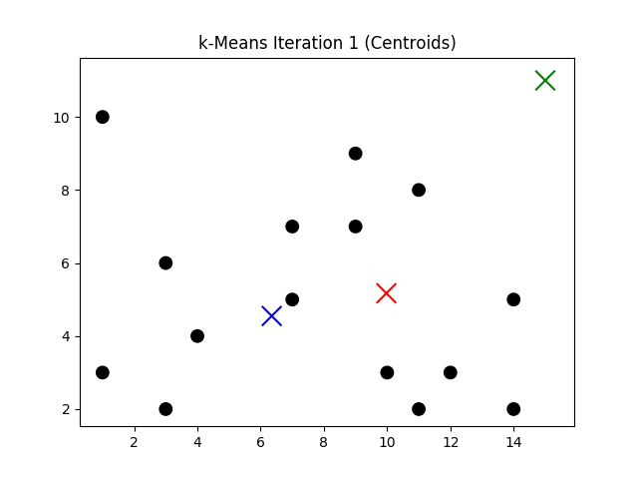
k-Means with bad random uniform init

Slide 48
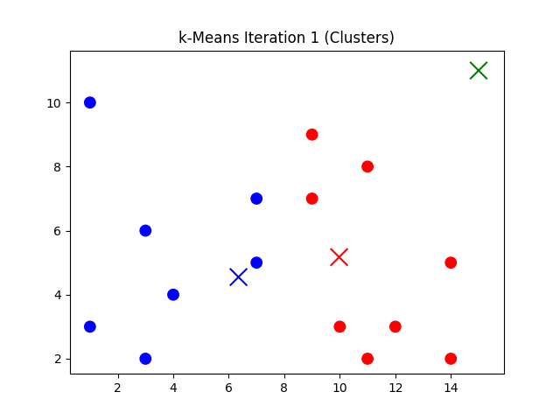
k-Means with bad random uniform init

Slide 49
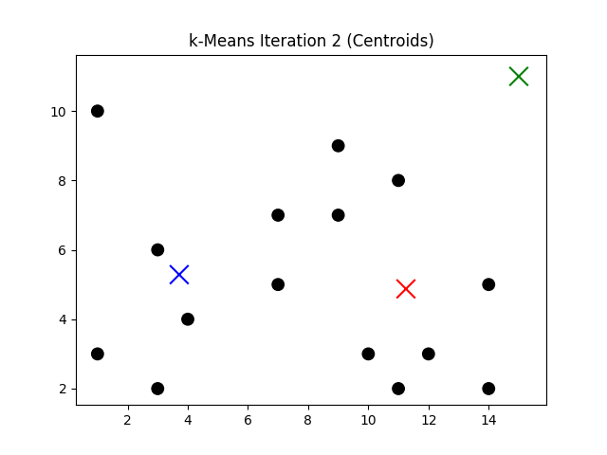
k-Means with bad random uniform init

Slide 50
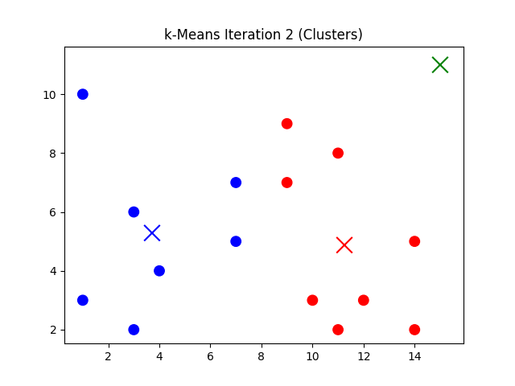
k-Means with bad random uniform init

Slide 51
k-Means with bad random uniform init
Converged, but only to two clusters!
One way to discourage this: sample from the range/distribution of the data
Another: use real points as the initial centroids!

Slide 52
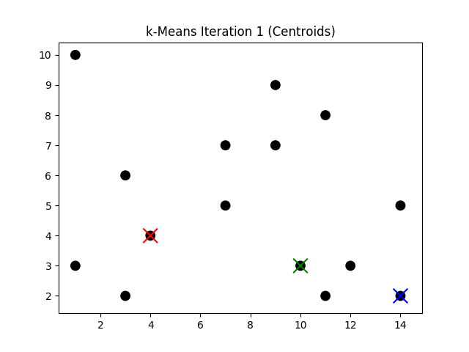
k-Means with random init from data

Slide 53
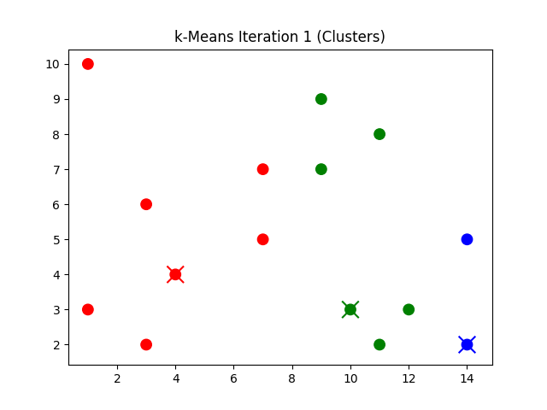
k-Means with random init from data

Slide 54
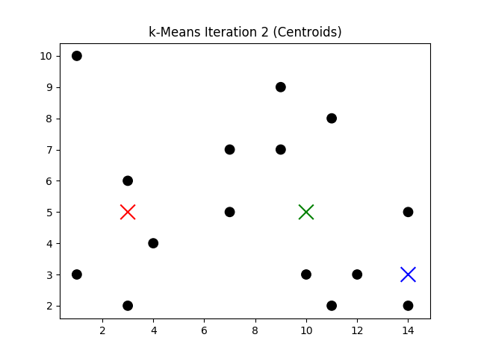
k-Means with random init from data

Slide 55
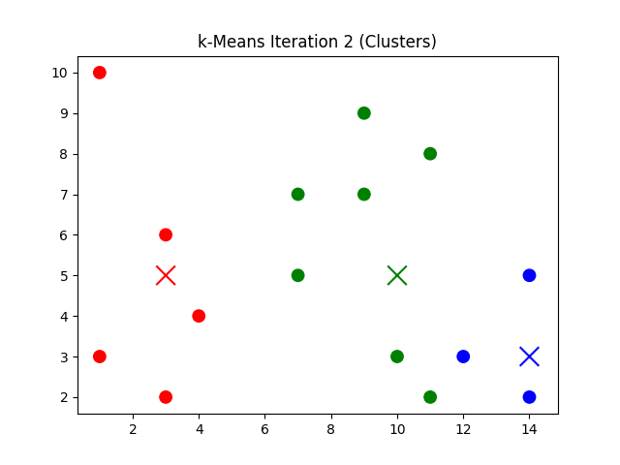
k-Means with random init from data

Slide 56
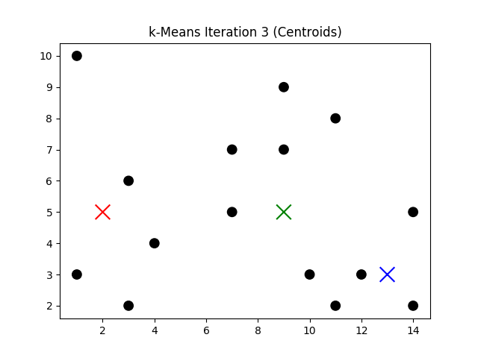
k-Means with random init from data

Slide 57
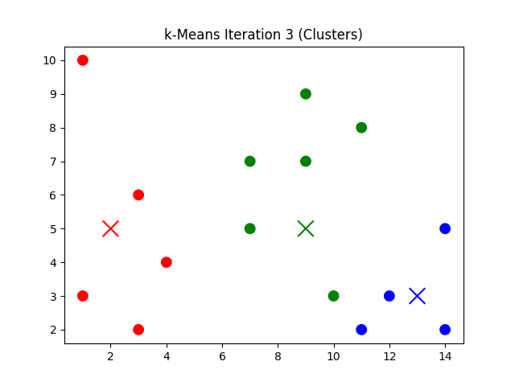
k-Means with random init from data

Slide 58
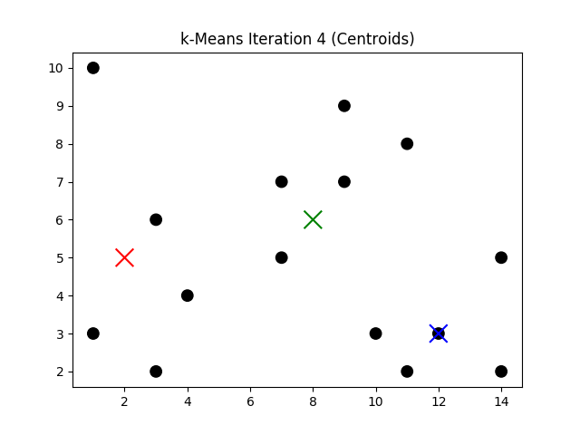
k-Means with random init from data

Slide 59
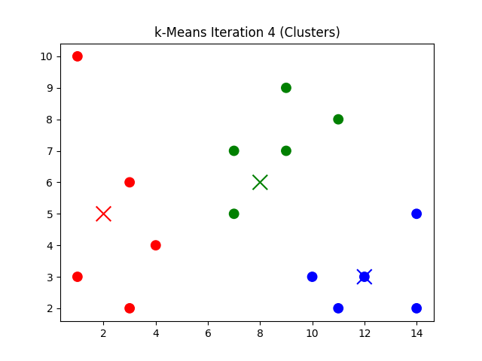
k-Means with random init from data

Slide 60
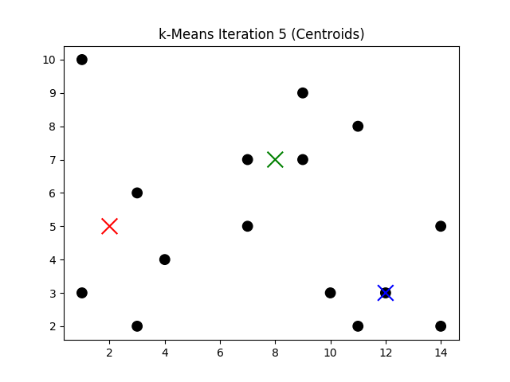
k-Means with random init from data

Slide 61
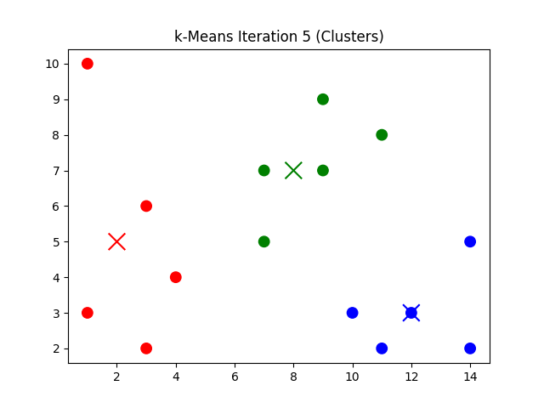
k-Means with random init from data

Slide 62
k-Means with random init from data
Converged!

Slide 63
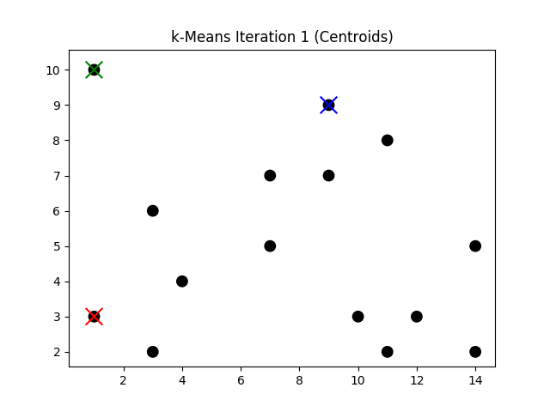
k-Means with bad (outlier) init

Slide 64
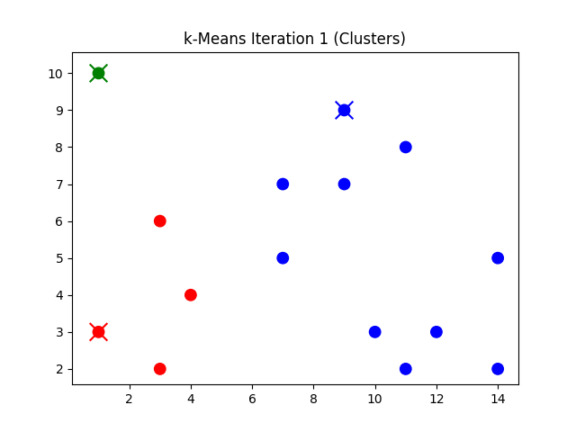
k-Means with bad (outlier) init

Slide 65
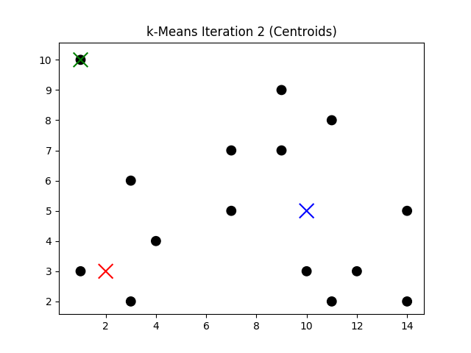
k-Means with bad (outlier) init

Slide 66
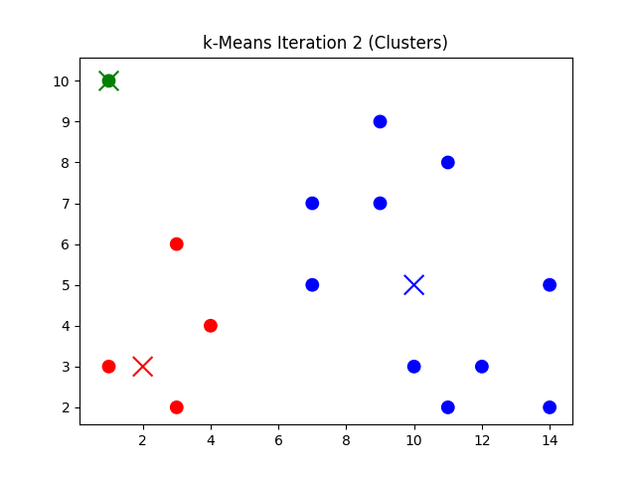
k-Means with bad (outlier) init

Slide 67
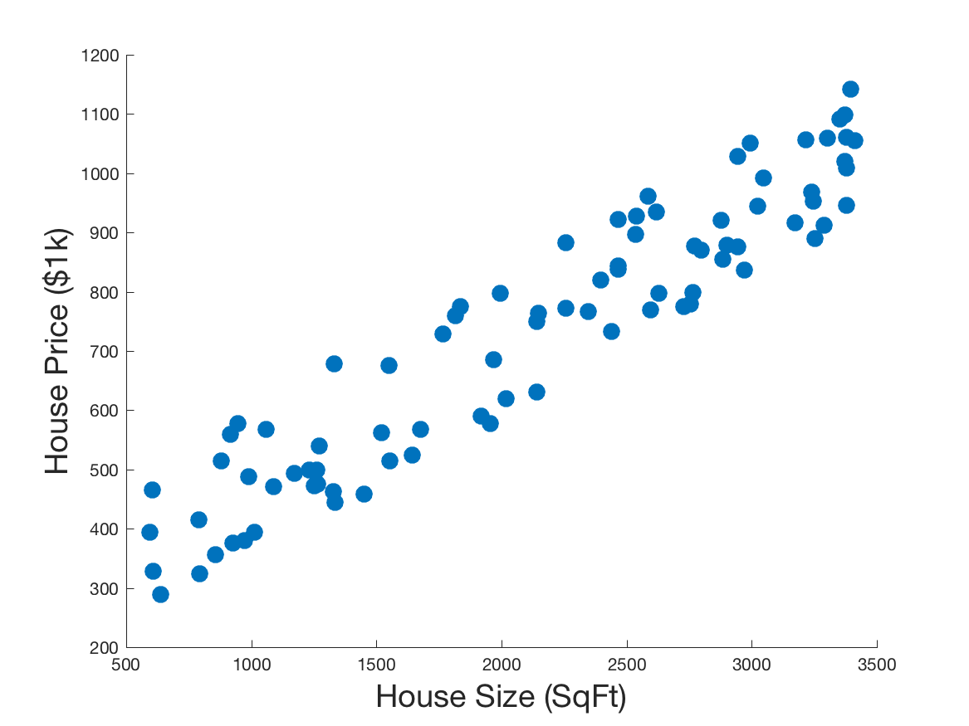
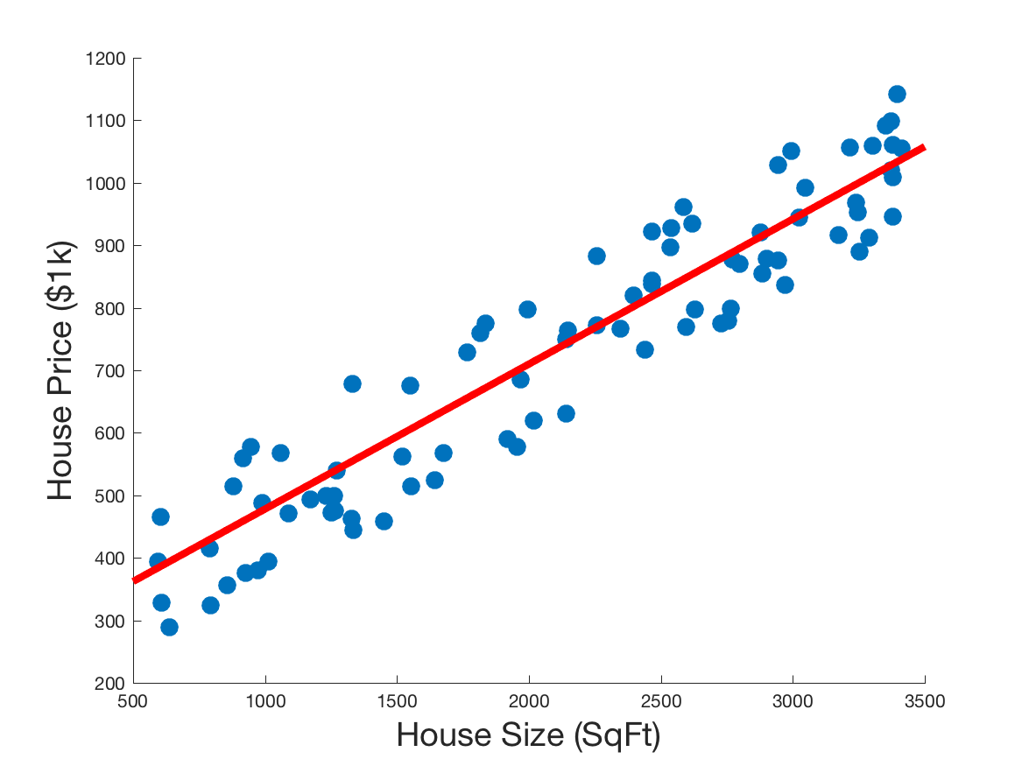



Least squares regression
Linear regression with a single variable is easy!
Let $x$ be the independent variable, $y$ be its dependent variable
We have observed samples $\left(x_{1},y_{1}\right)…(x_{N},y_{N})$
Calculate the line of best fit:
$$y=w_{1}x+w_{0}$$
$w_{1},w_{0}$ are the model parameters to learn

Slide 68




Least squares regression
With observed: $\left(x_{1},y_{1}\right)…(x_{N},y_{N})$
We want: $y=w_{1}x+w_{0}$
Least squares: Minimizing L2 loss (sum of squared errors)
$$L\left(\vec{w};x,y\right)=\sum_{j=1}^{N}{{\left(y_{j}−\left(w_{1}x_{j}+w_{0}\right)\right)}^{2}}$$
$${\vec{w}}^{∗}=\underset{\vec{w}}{argmin}{L(\vec{w};x,y)}$$

Slide 69






Least squares regression
To find the values for $w_{0},w_{1}$ that satisfy this:
$$L\left(\vec{w};x,y\right)=\sum_{j=1}^{N}{{\left(y_{j}−\left(w_{1}x_{j}+w_{0}\right)\right)}^{2}}$$
$${\vec{w}}^{∗}=\underset{\vec{w}}{argmin}{L(\vec{w};x,y)}$$
Just calculate the partial derivatives w.r.t. $w_{0},w_{1}$
$$\frac{δ}{δw_{1}}L\left(\vec{w};x,y\right)=\sum_{j}{2x_{j}(w_{1}x_{j}+w_{0}−y_{j})}$$
$$\frac{δ}{δw_{0}}L\left(\vec{w};x,y\right)=\sum_{j}{2 (w_{1}x_{j}+w_{0}−y_{j})}$$

Slide 70


Least squares regression
To find the values for $w_{0},w_{1}$ that satisfy this:
$$L\left(\vec{w};x,y\right)=\sum_{j=1}^{N}{{\left(y_{j}−\left(w_{1}x_{j}+w_{0}\right)\right)}^{2}}$$
$${\vec{w}}^{∗}=\underset{\vec{w}}{argmin}{L(\vec{w};x,y)}$$
Set them to 0 and solve to get
$$w_{1}=\frac{N\left(∑x_{j}y_{j}\right)−\left(∑x_{j}\right)\left(∑y_{j}\right)}{N\sum{x_{j}^{2}}−∑x_{j}^{2}}$$
$$w_{0}=\frac{∑y_{j}−w_{1}∑x_{j}}{N}$$
Done!

Slide 71


Visualizing least squares regression
We can also think about constructing an error surface from the loss function
$$L\left(\vec{w};x,y\right)=\sum_{j=1}^{N}{{\left(y_{j}−\left(w_{1}x_{j}+w_{0}\right)\right)}^{2}}$$
What we’re doing is finding the minimum point on this surface.

Slide 72

Visualizing least squares regression
We can also think about constructing an error surface from the loss function
$$L\left(\vec{w};x,y\right)=\sum_{j=1}^{N}{{\left(y_{j}−\left(w_{1}x_{j}+w_{0}\right)\right)}^{2}}$$
What we’re doing is finding the minimum point on this surface.
Is there only one minimum?
Easier to see when it’s zoomed!

Slide 73



Least squares with a non-linear function
Consider data from a nonlinear distribution.
Here, assume sinusoidal
We now want the sine wave of best fit
$$y=sin⁡(w_{1}x+w_{0})$$
Considering only two of the 4 possible parameters for convenience

Slide 74


Least squares with a non-linear function
With observed: $\left(x_{1},y_{1}\right)…(x_{N},y_{N})$
We want: $y=sin⁡(w_{1}x+w_{0})$
Least squares: Minimizing L2 loss (sum of squared errors)
$$L\left(\vec{w};x,y\right)=\sum_{j=1}^{N}{{\left(y_{j}−sin\left(w_{1}x_{j}+w_{0}\right)\right)}^{2}}$$
$${\vec{w}}^{∗}=\underset{\vec{w}}{argmin}{L(\vec{w};x,y)}$$

Slide 75


Least squares with a non-linear function
$$L\left(\vec{w};x,y\right)=\sum_{j=1}^{N}{{\left(y_{j}−sin\left(w_{1}x_{j}+w_{0}\right)\right)}^{2}}$$
Using L2 loss
Again, calculate the partial derivatives w.r.t. $w_{0},w_{1}$
$$\frac{δ}{δw_{1}}L\left(\vec{w};x,y\right)=\sum_{j}{2x_{j}\cos\left(w_{1}x_{j}+w_{0}\right)\left(\sin\left(w_{1}x_{j}+w_{0}\right)−y_{j}\right)}$$
$$\frac{δ}{δw_{0}}L\left(\vec{w};x,y\right)=\sum_{j}{2\cos\left(w_{1}x_{j}+w_{0}\right)\left(\sin\left(w_{1}x_{j}+w_{0}\right)−y_{j}\right)}$$

Slide 76


Least squares with a non-linear function
$$\frac{δ}{δw_{1}}L\left(\vec{w};x,y\right)=\sum_{j}{2x_{j}\cos\left(w_{1}x_{j}+w_{0}\right)\left(\sin\left(w_{1}x_{j}+w_{0}\right)−y_{j}\right)}$$
$$\frac{δ}{δw_{0}}L\left(\vec{w};x,y\right)=\sum_{j}{2\cos\left(w_{1}x_{j}+w_{0}\right)\left(\sin\left(w_{1}x_{j}+w_{0}\right)−y_{j}\right)}$$
But there’s no unique solution for these!
In many cases, there won’t even be a closed form solution

Slide 77


Least squares with a non-linear function
Here’s the loss function over $w_{o},w_{1}$
Very much non-convex!
Lots of local minima
Instead of solving exactly, iterative solution with gradient descent

Slide 78

Gradient descent algorithm
${\vec{w}}^{0}←$ random point in $w_{0},w_{1}$ space
loop until convergence do
for each $w_{i}$ in ${\vec{w}}^{t}$ do
$w_{i}←w_{i}−α\frac{δ}{δw_{i}}L(\vec{w};x,y)$
Learning rate

Slide 79


Gradient descent
$$L(\vec{w};x,y)$$
$$w_{i}$$
Notes:
Good! Escaped the local solution for a better solution.

Slide 80
Gradient descent
$$L(\vec{w};x,y)$$
$$w_{i}$$
Notes:
Good! Escaped the local solution for a better solution.

Slide 81


Let’s run it!
Simpler example:
Data
Loss

Slide 82


Let’s run it!
We have our partial derivatives:
$$\frac{δ}{δw_{1}}L\left(\vec{w};x,y\right)=\sum_{j}{2x_{j}\cos\left(w_{1}x_{j}+w_{0}\right)\left(\sin\left(w_{1}x_{j}+w_{0}\right)−y_{j}\right)}$$
$$\frac{δ}{δw_{0}}L\left(\vec{w};x,y\right)=\sum_{j}{2\cos\left(w_{1}x_{j}+w_{0}\right)\left(\sin\left(w_{1}x_{j}+w_{0}\right)−y_{j}\right)}$$
We have our data:
$$\left(2.04, 0.94\right) \left(6.15, −0.33\right)…$$

Slide 83

Gradient descent example
Start with random $w_{0}=0.4, w_{1}=0.4$

Slide 84




Gradient descent example
$$w_{i}←w_{i}−α\frac{δ}{δw_{i}}L(\vec{w};x,y)$$
Gradient descent update:
$$α=0.0001$$
$$\frac{δ}{δw_{1}}L\left(\vec{w};x,y\right)=\sum_{j}{2x_{j}\cos\left(w_{1}x_{j}+w_{0}\right)\left(\sin\left(w_{1}x_{j}+w_{0}\right)−y_{j}\right)}$$
$$=2\left(2.04\right)\cos\left(0.4\left(2.04\right)+0.4\right)\left(\sin\left(0.4(2.04)+0.4\right)−0.94\right) \\ +2\left(6.15\right)\cos\left(0.4(6.15)+0.4\right)\left(\sin\left(0.4\left(6.15\right)+0.4\right)+0.33\right) \\ +… \\ =−189$$
$$w_{1}←0.4−0.0001(−189)≈0.42$$

Slide 85


Gradient descent example
$$w_{i}←w_{i}−α\frac{δ}{δw_{i}}L(\vec{w};x,y)$$
Gradient descent update:
$$α=0.0001$$
$$\frac{δ}{δw_{0}}L\left(\vec{w};x,y\right)=\sum_{j}{2\cos\left(w_{1}x_{j}+w_{0}\right)\left(\sin\left(w_{1}x_{j}+w_{0}\right)−y_{j}\right)}$$
$$=2\cos\left(0.4\left(2.04\right)+0.4\right)\left(\sin\left(0.4(2.04)+0.4\right)−0.94\right) \\ +2\cos\left(0.4(6.15)+0.4\right)\left(\sin\left(0.4\left(6.15\right)+0.4\right)+0.33\right) \\ +… \\ =−20.5$$
$$w_{0}←0.4−0.0001(−20.5)≈0.402$$

Slide 86

Gradient descent example
After 1 iteration, we have $w_{0}=0.402, w_{1}=0.42$

Slide 87

Gradient descent example
After 2 iterations, we have $w_{0}=0.404, w_{1}=0.44$

Slide 88

Gradient descent example
After 3 iterations, we have $w_{0}=0.405, w_{1}=0.45$

Slide 89

Gradient descent example
After 4 iterations, we have $w_{0}=0.407, w_{1}=0.47$

Slide 90

Gradient descent example
After 5 iterations, we still have $w_{0}=0.407, w_{1}=0.47$

Slide 91

Gradient descent example
By 13 iterations, we’ve pretty well converged around $w_{0}=0.409, w_{1}=0.49$

Slide 92
What about the complicated example?
Gradient descent doesn’t always behave well with complicated data
It can
Overfit
Oscillate

Slide 93

Gradient descent example
Start with random $w_{0}=3.1, w_{1}=0.2, α=0.01$

Slide 94

Gradient descent example
After 1 iteration

Slide 95

Gradient descent example
After 2 iterations

Slide 96

Gradient descent example
After 3 iterations

Slide 97

Gradient descent example
After 4 iterations

Slide 98

Gradient descent example
After 5 iterations

Slide 99

Gradient descent example
After 6 iterations

Slide 100

Gradient descent example
After 7 iterations

Slide 101

Gradient descent example
After 8 iterations

Slide 102

Gradient descent example
After 9 iterations

Slide 103

Gradient descent example
After 10 iterations

Slide 104
Next time
Logistic regression
Neural networks (and backpropagation training)

